Slide 1
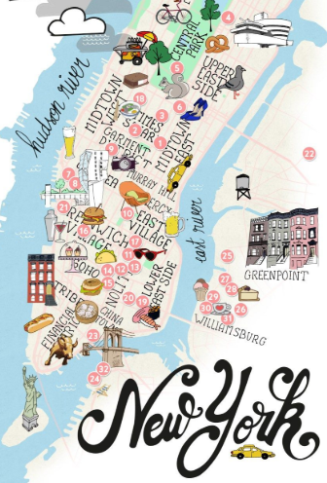
Know-b4-u-go
ERIC LIEU
MJ VILLACRESES
FRANCIS IMPERIAL
AMANDA WISHNIE
Notes:
How many of you have rented an Airbnb?
Who did research on the cities they were visiting prior to making a decision?
I’m assuming you has had to click through multiple different websites to find everything you wanted to know…

Slide 2
How are we going to help you?
WHITESPACE OPPORTUNITY Application that provides all the data you need to plan your next trip
FEATURES Airbnb pricing history Crime Data overview Where to eat & drink Insights Analysis
MOTIVATIONS:
SIMPLIFYING THE DECISION MAKING PROCESS WHEN PLANNING A TRIP
WHERE:
AIRBNB OPEN SOURCE
ZOMATO
VADER PYTHON PACKAGE
HOW:
PYTHON
HTML/CSS
JAVASCRIPT
API’s
MACHINE LEARNING
Notes:
That’s where we come! We are filling a white-space in the market that’s a one stop shop to get a holistic perspective of where you’ll be staying
KNOW B4 U GO!
We currently have 4 main features rolled out on our beta site and for our test are only focusing on New York City
Airbnb pricing history from 2018 by neighborhood
NYPD crime data from 2018
What bars and restaurants there are by neighborhood / rating
Insights Analysis overviewing Airbnb comments from 2018

Slide 3
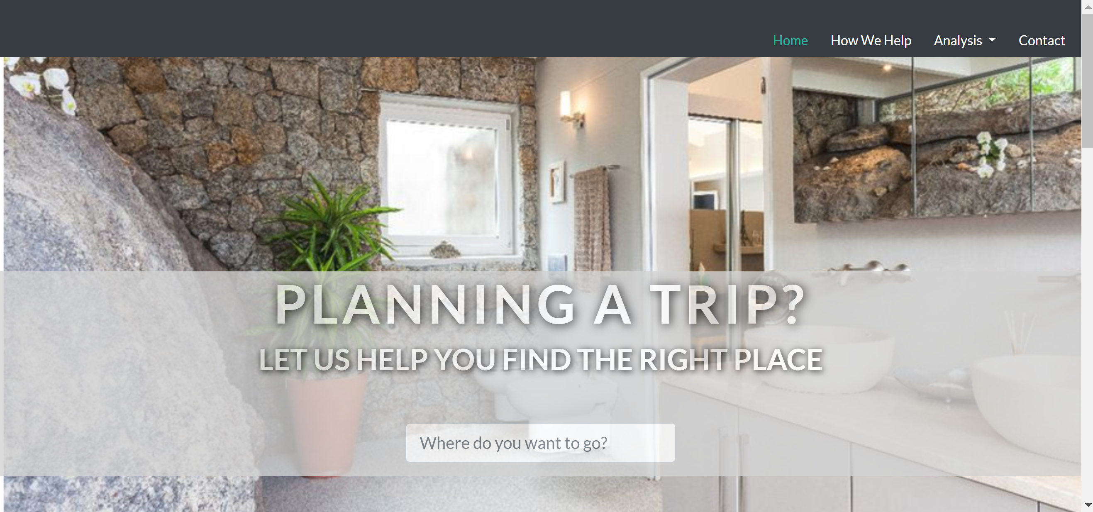
WHAT DID WE DO?
Notes:
We built a website with HTML/CSS to display our findings and provide an interactive UI/UX for our users
This is currently only a web-based application but will eventually launch as an app.
I am now going to pass it over to Francis so he can take you through our amazing features

Slide 4
AIRBNB MAP DEVELOPMENT
INTERACTIVE MAP
API
Search Function
&
Homepages
Airbnb Price Predictor & Scale
Suggestions
Feature

Slide 5










crime MAP DEVELOPMENT
NYPD YTD Complaint Data
Jupyter Notebook
Leaflet GeoMapping
Notes:
Downloaded NYPD Complaint Data Year-to-Date from NYC OpenData ins CSV format
Using python in Jupyter Notebook and pandas dataframe, filtered for relevant columns (e.g. offense description, precinct, borough, violation type, and most importantly the latitude and longitude coordinates) to create a cleaned up CSV file for 2018 crime data with relevant data
Created child CSV files by violation type (e.g. assault, larceny, drug-related, etc.)
Using python and pandas, each CSV file was converted into a list of dictionaries before finally being converted into json files
Based on our Geo-mapping homework, I created a map that would plot all the crime reports by type and color onto the NYC map
Then, combined it with Francis’ neighboorhood pricing map by overlaying it with various crime layers
Search function was also included using a leaflet control search plugin – leveraging Francis’s already made GeoJson data, I re-used the same neighborhood data to create search and zoom by neighborhood

Slide 6
insights analysis process
INTERACTIVE MAP
API
Search Function
&
Homepages
Airbnb Price Predictor & Scale
Suggestions
Feature

Slide 7
KNOW-B4-U-GO FUTURE IMPLEMENTATIONS
GLOBAL EXPANSION:
ADD ALL GLOBAL MAJOR CITIES TO THE SITE
EVENTUALLY ADD SMALLER CITIES THAT ARE TRYING TO INCREASE TOURISM
Apt Owner
&
Renter
Global Expansion
Search Function
&
Homepages
Airbnb Price Predictor & Scale
Suggestions
Feature
SEARCH FUCNTION & HOMEPAGES:
HOMEPAGE FORM BUTTON THAT ALLOWS YOU TO SEARCH FOR THE CITY YOU WANT TO LEARN MORE ABOUT
CREATE HOMEPAGES FOR EACH CITY WE FEATURE ON THE SITE
PRICE PREDICTOR & SCALE:
WITH MACHINE LEARNING, DEVELOP AN AIRBNB PRICE PREDICTOR THAT LEVERAGES HISTORICAL DATA BY NEIGHBORHOOD OR CITY
GOAL OF THIS IS TO HELP APT OWNERS UNDERSTAND THE CURRENT AND FUTURE PRICING ENVIORNMENT
SUGGESTIONS FEATURE:
MAKE SUGGESTIONS ON WHERE TO TRAVEL BASED ON DIFFERENT USER INPUT CONDITIONS
RELAXING VACATION WITH LITTLE CRIME?
BUDGETED TRIP? TRAVEL BASED ON AIRBNB PRICING
PARTY ANIMAL? STAY WHERE THE BARS ARE

